Slide 1


Virtual Reality to Improve Public Speaking
Presenter: Umair Qureshi
Faculty Advisor: Dr. Arkady Retik
Sponsor: Colby Easton

Slide 2

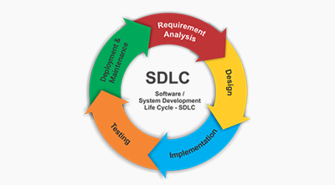
About the Company
Company: Anxious Software Inc.
Established in April 2019
Consists of a team of 5 members (Colby Easton, Kyle Lotterer, Josh Kennedy, Mckinley Melton and myself)
Started as a group in CSS 350 with Dr. Arkady Retik and we produced the idea as we saw and acknowledged the public speaking struggles that we had
Company was established to oversee the development cycle of the application (Virtual Presenter Pro)

Slide 3

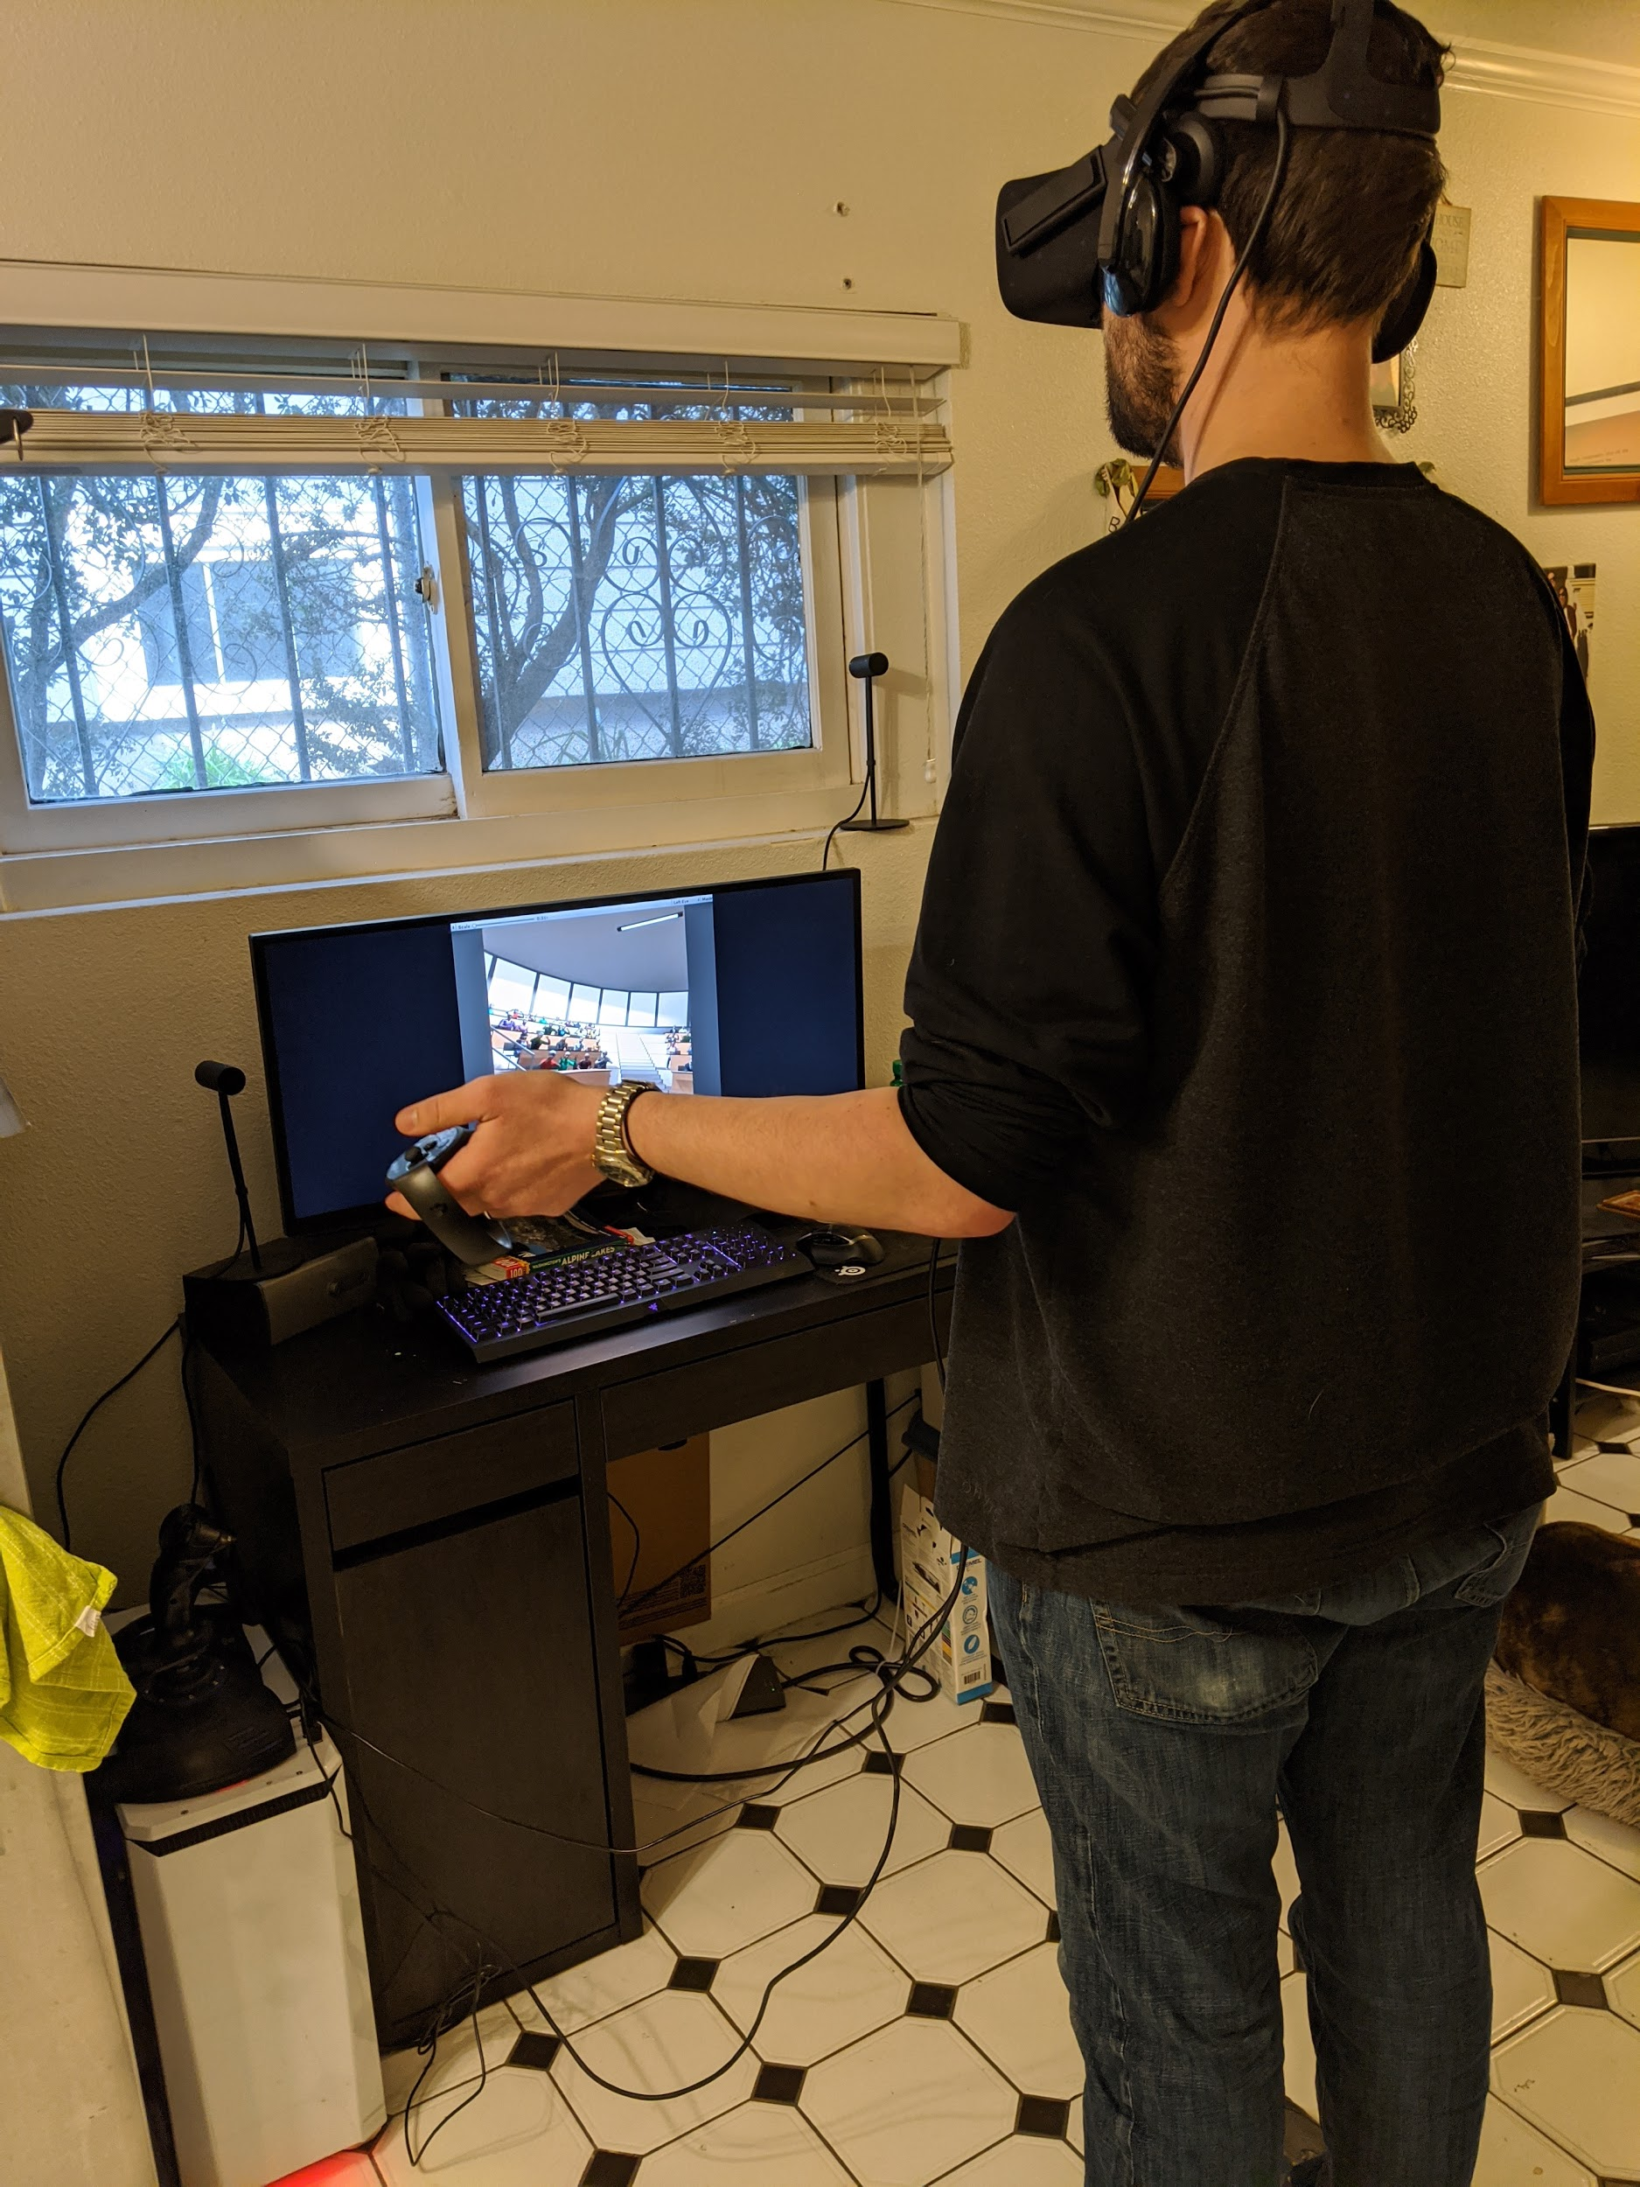
Background & Overview
Anxious Software aimed to develop a commercially viable application which helped people overcome their public speaking fears by simulating real world situations and providing accurate feedback statistics such as filler word count and look direction percentage
Worked with 1 other individual, with close guidance, for our capstone

Slide 4
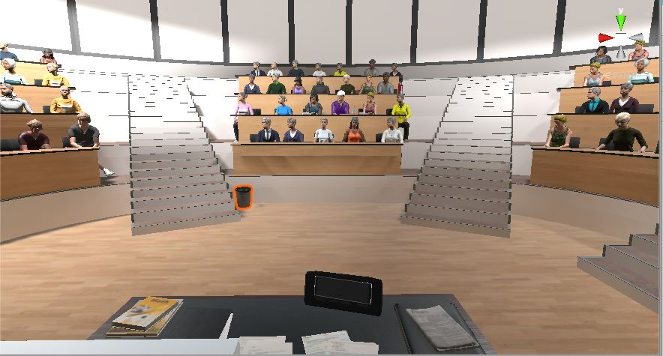
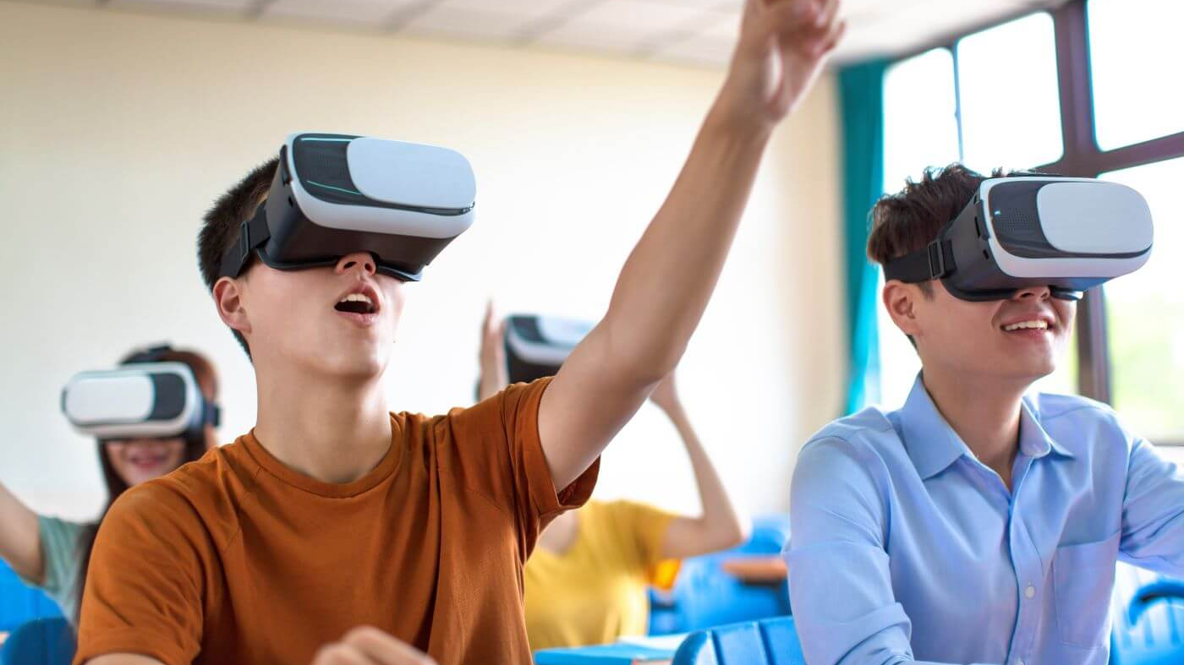
Why Virtual Reality?
Provide a safe alternative dimension for users to practice public speaking without the fears
Models very realistic and live settings
The future of technology for learning and educational purposes

Slide 5
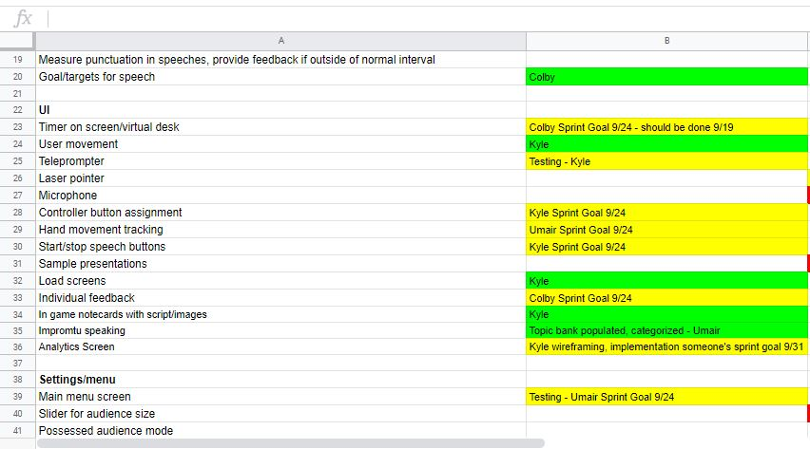
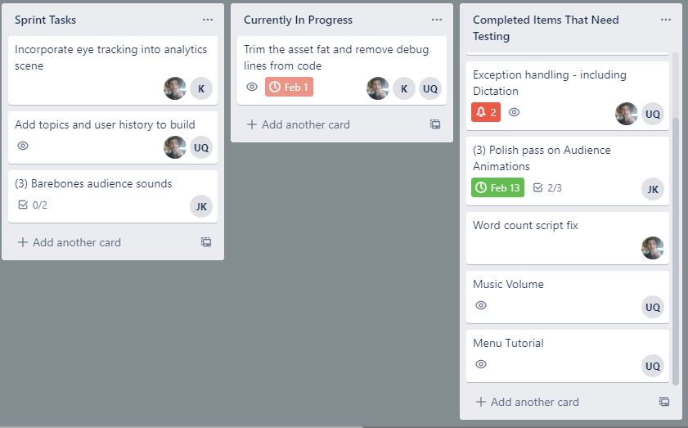
Requirements & Design
Multiple team meetings to decide what features were to be implemented for Minimum Viable Product (MVP)
Decide on flow and design of application including environments
Determine timeline for development and delegate sprint tasks using Trello Board

Slide 6
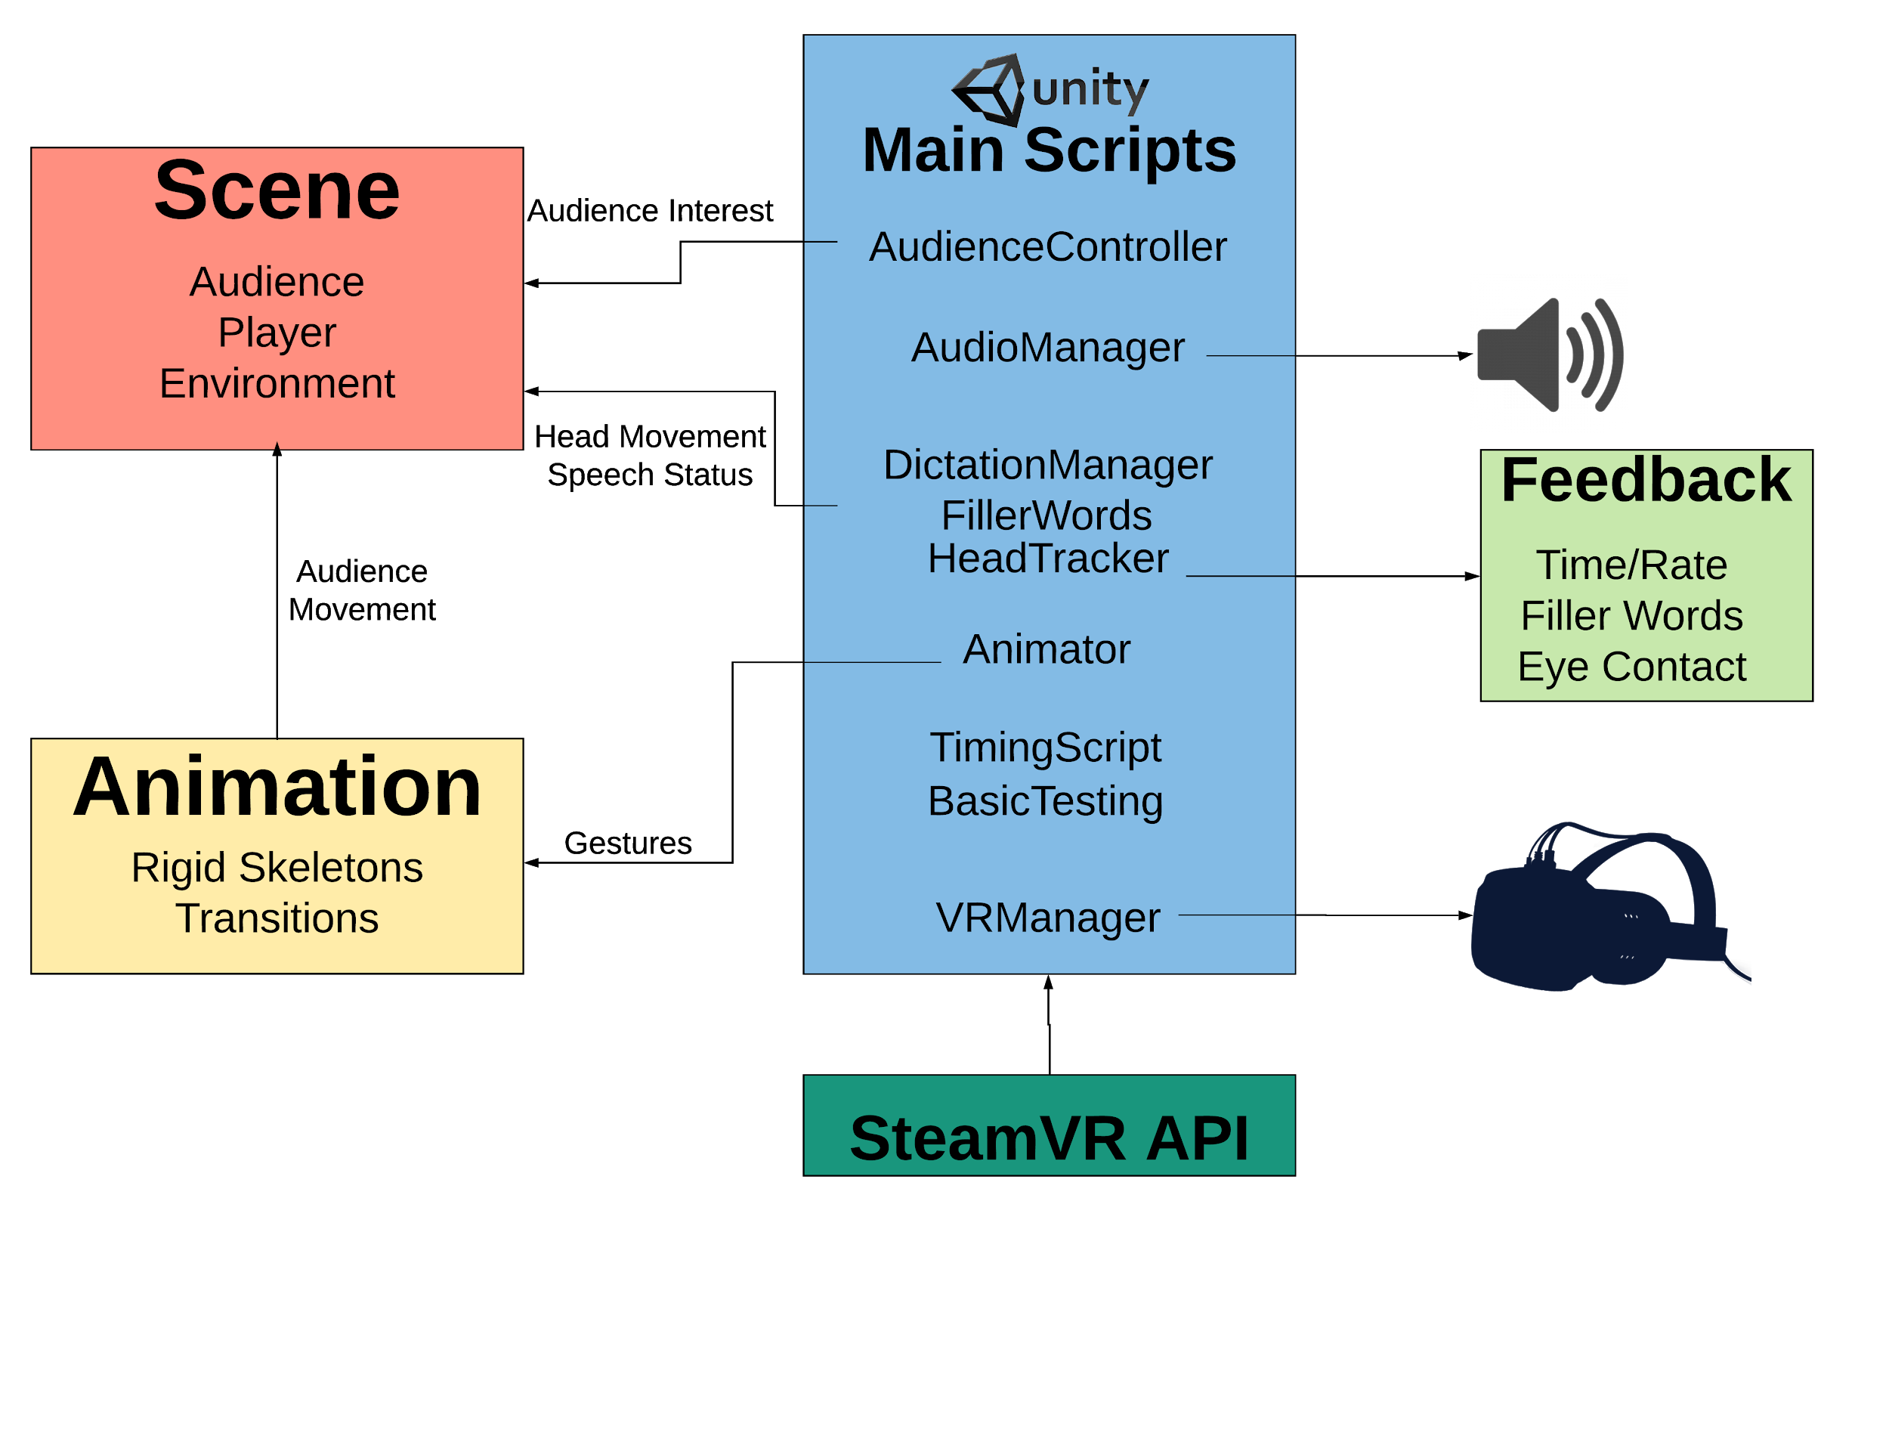
Project Diagram

Slide 7
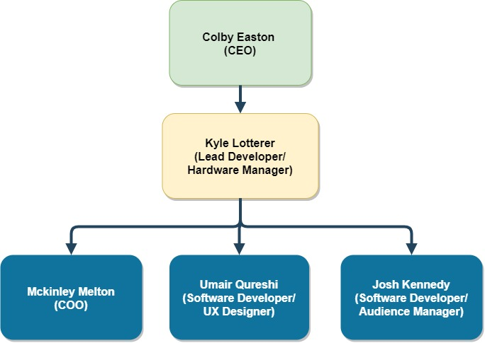
Roles & Team

Slide 8
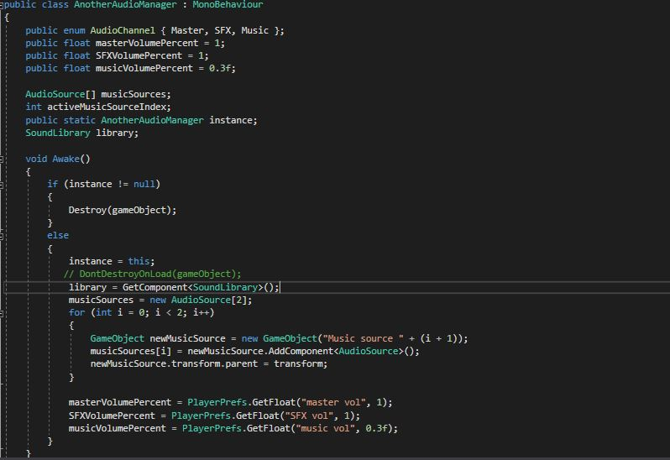
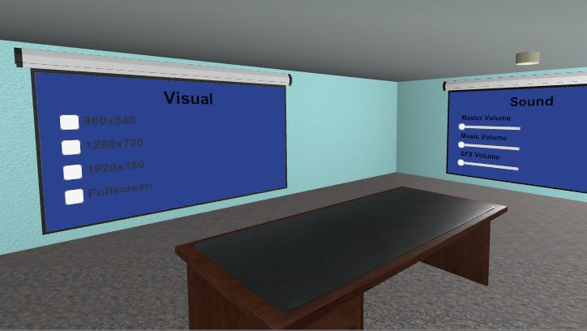
My Contributions
Design an options room and code scripts to integrate it into the application
Audio setting (music, sound effects, volume sliders)
Visual settings
Keep the interface simple and relevant

Slide 9
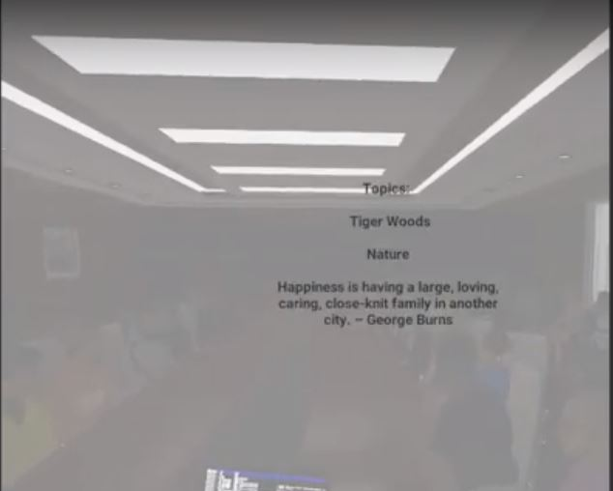
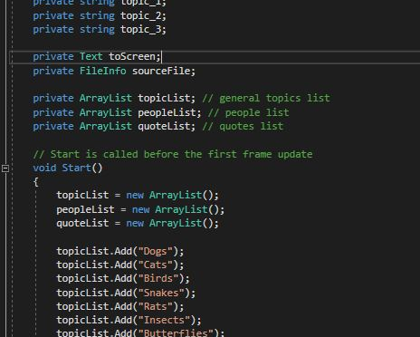
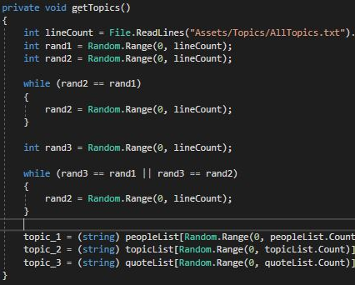
My Contributions
Create a list of random topics for impromptu speaking mode
Generate and display 3 random topics to user when they start their speech

Slide 10
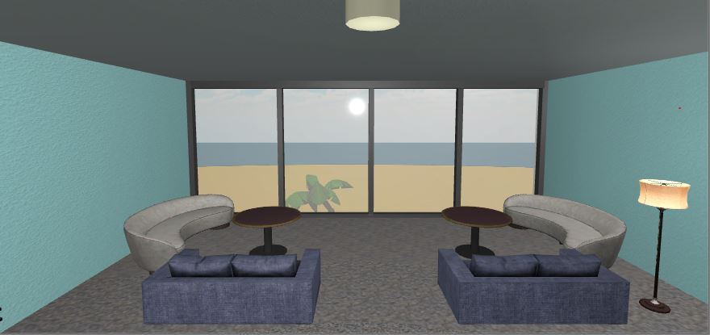
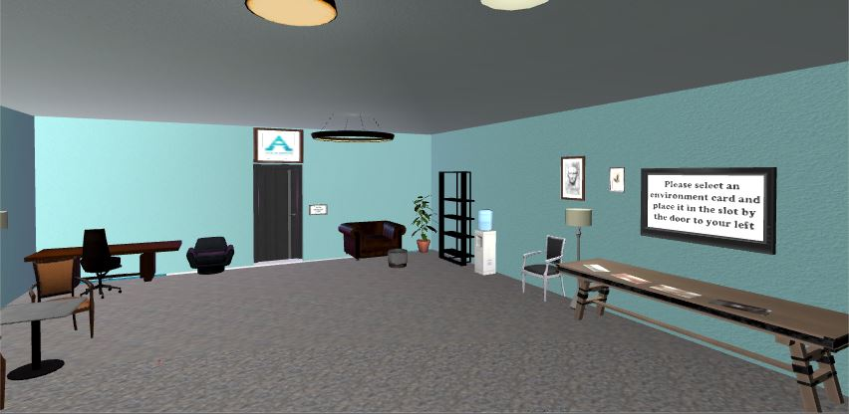
My Contributions
Usability testing to make sure application is simple to use and accessible
Main menu scene is aesthetic, relaxing and well positioned as a spawn point
Enough space to navigate around the scene
Clear instructions to play the game

Slide 11
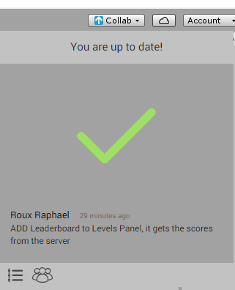
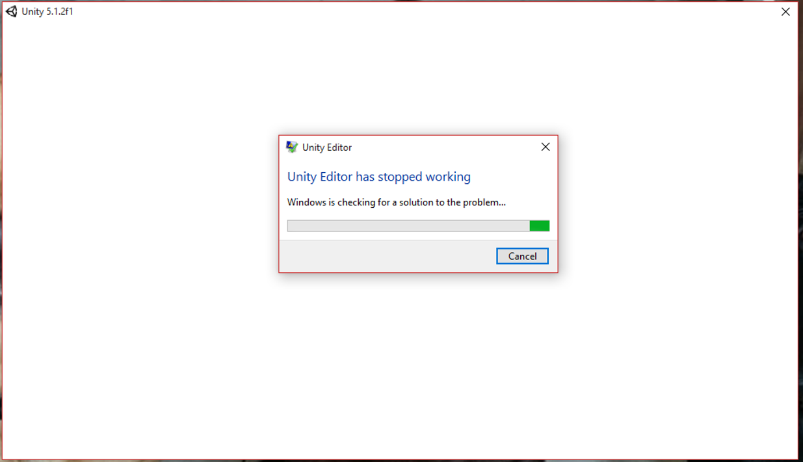
Challenges
Learning the Unity environment and technologies
Integrating changes from different local copies to the cloud build
FREEZING ISSUES!!
Lack of usability tests due to limited VR headsets

Slide 12
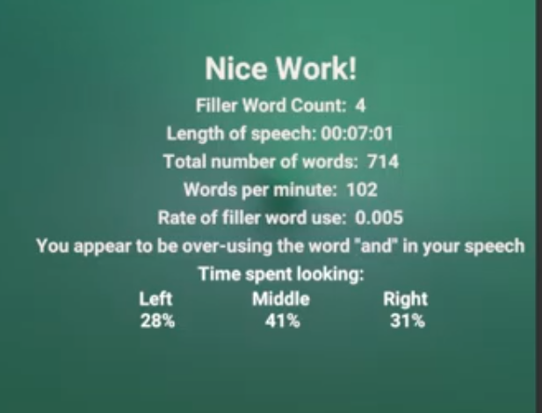
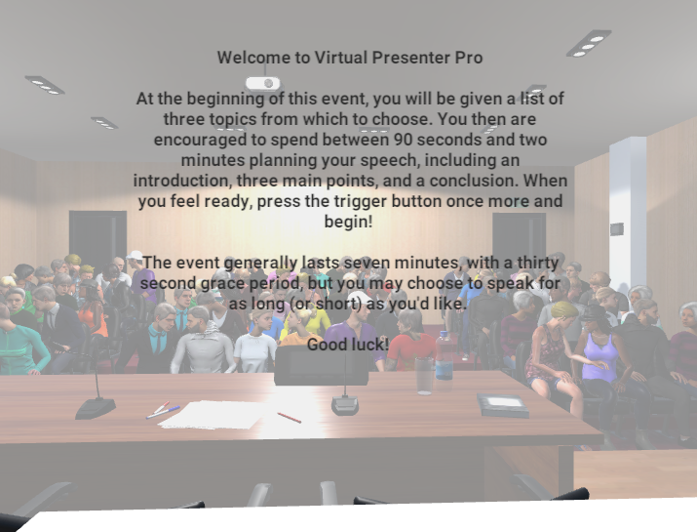
Project Results
Application successfully reached MVP release and is fully functioning
Multiple environments can be selected, and speech data is collected with feedback shown at the end
Hardware integration for Oculus Rift, HTC Vive and Windows Mixed Reality headsets all successful

Slide 13
Skills Developed & Takeaways
Test early and often after every major change to ensure all components are correctly integrated into cloud build and don’t crash
C# coding
Unity Game Engine development
Team collaboration
Agile development practices
Version control
Learning by doing
Usability and user centered design

Slide 14














Tools

Slide 15

Acknowledgments and Useful Courses
I would like to thank my fellow coworkers Kyle Lotterer, Colby Easton, Josh Kennedy and McKinley Melton for bringing this project into action as well as Dr. Arkady Retik for his guidance, insight, support and connections whenever I needed it.
CSS 342/343 (Data Structures & Algorithms)
CSS 350 (Management Principles for Computing Professionals)
CSS 360 (Software Engineering)
CSS 370 (Analysis and Design)
CSS 478 (Usability and User-Centered Design)
CSS 301 (Technical Writing)
CSS 371 (Business of Technology)

Slide 16
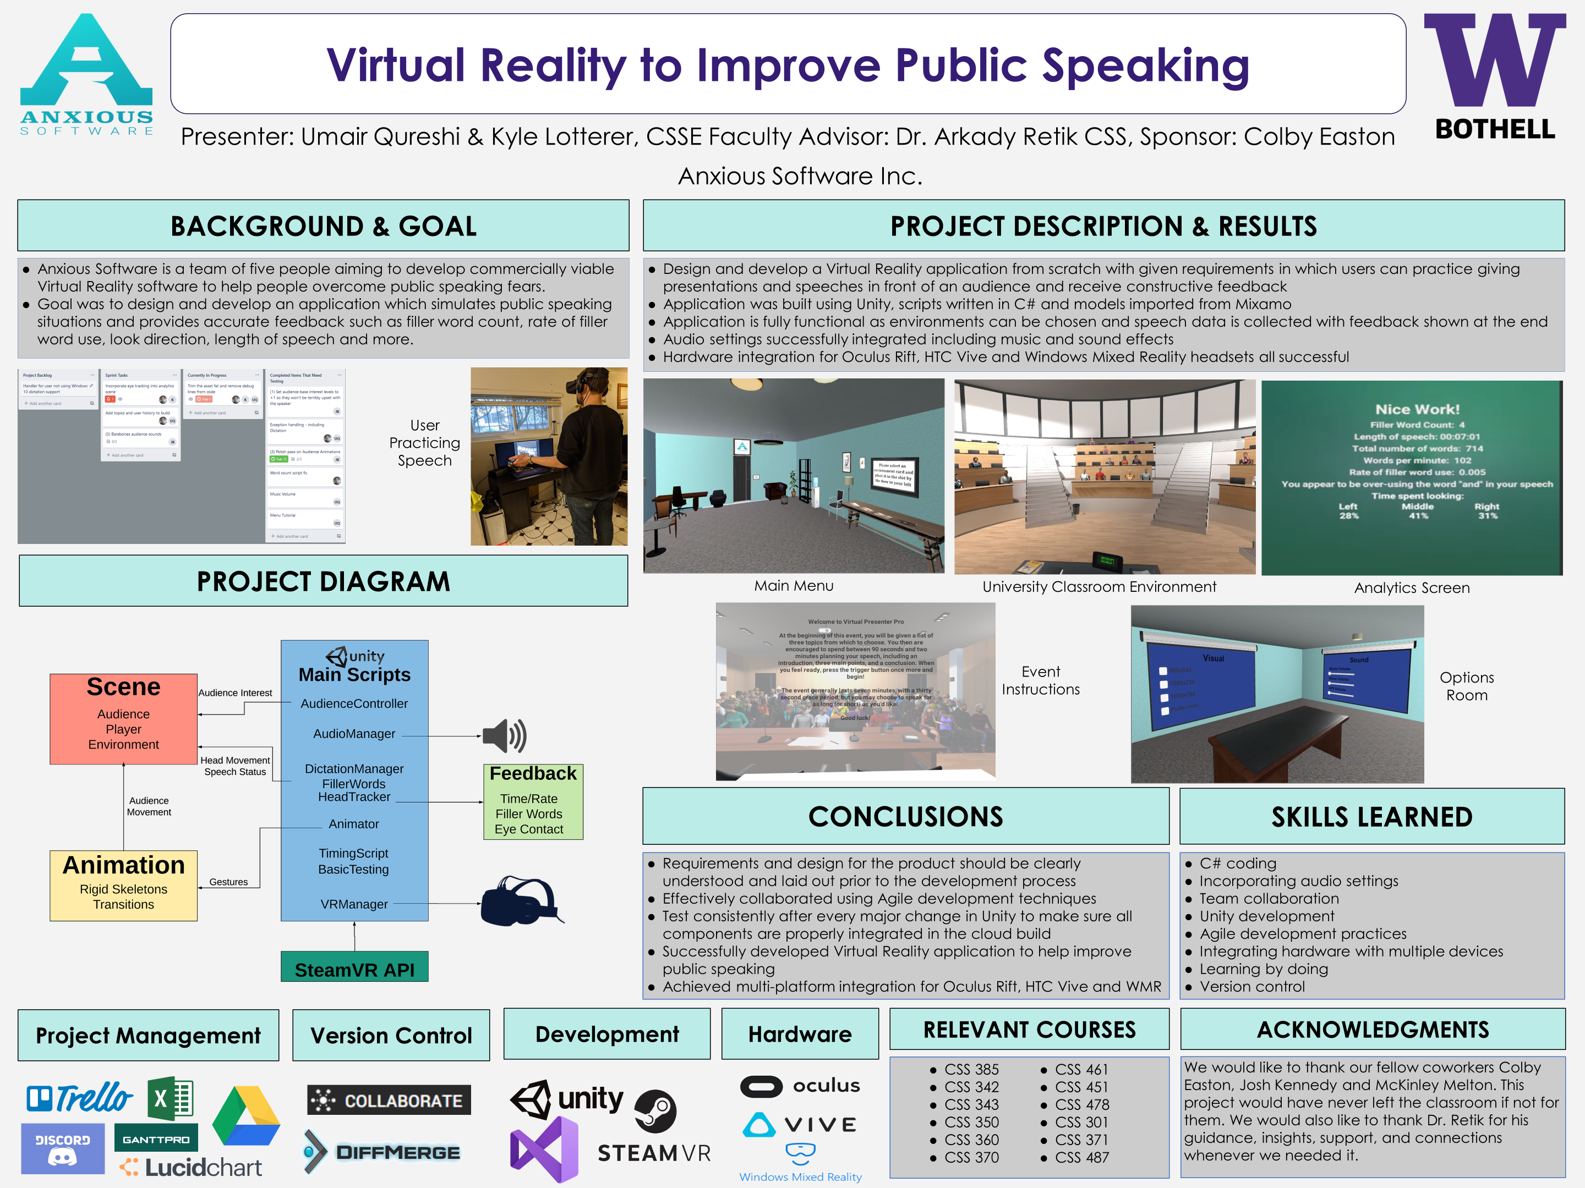

Slide 17

Questions?

